Slide 1
I2C Protocol Implementation

Slide 2
Group Members
Amit Bhorania
Ashutosh Gajankush
Ajinkya Bobade
Ravi Patel
Vaibhav Jindal

Slide 3
Contents
Problem Description
Introduction
I2C Protocol working
System Design
Project Demo
FPGA Implementation
Project Outcome

Slide 4
Project Definition
Design and Implement I2C Slave Hardware module using Verilog HDL

Slide 5
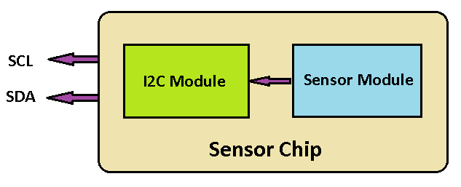
Importance
Increasing use of Sensors in the Industry
Most of the Sensors supports I2C Interface for communication
Ready made I2C Slave Module
Design new chips with easy interface
Less time for Design and Development

Slide 6

How I2C works ?
Two wire bi-directional serial protocol
  SCL (Serial Clock)
  SDA (Serial Data Line)
Master – Slave approach
Multiple devices can communicate on single bus
Master initiate the transfer and provides the clock
Start/ Stop bit
Particular device will be selected based on the slave address
Half Duplex Communication & Ack Mechanism

Slide 7
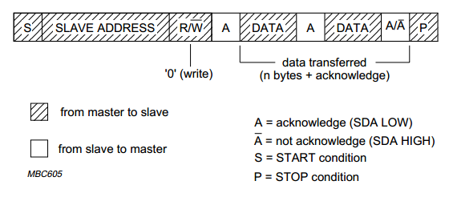
Slave Read Mode
Master Sends Start Bit and Slave Address
Read/Write bit is set as 0 for Master write and Slave read
Slave Reads the data from Master and sends back the ACK
Multi-byte Transfer supported

Slide 8
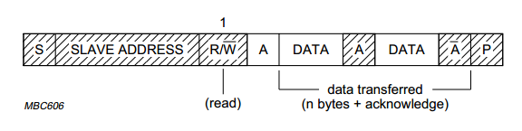
Slave Write Mode
Master Sends Start Bit and Slave Address
Read/Write bit is set as 1 for Master read and Slave write
Slave Sends the data to Master and reads back the ACK
Multi-byte Transfer supported

Slide 9
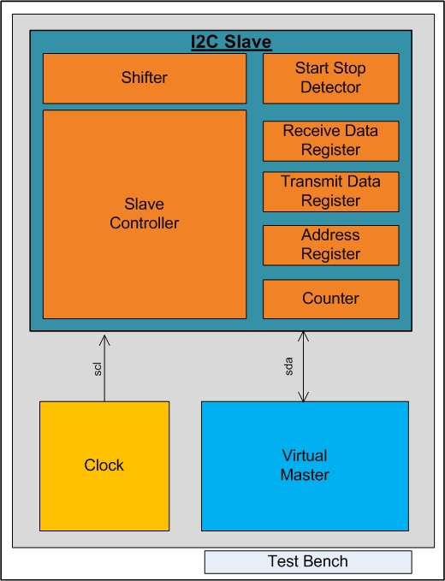
Verilog Design - Modules

Slide 10
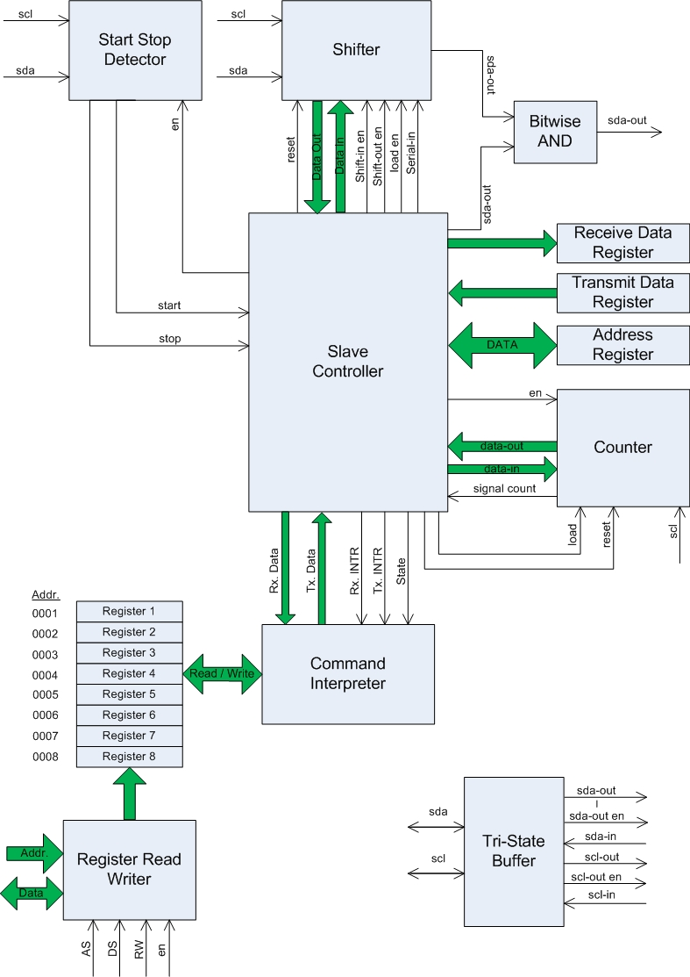
Verilog Design - Slave

Slide 11
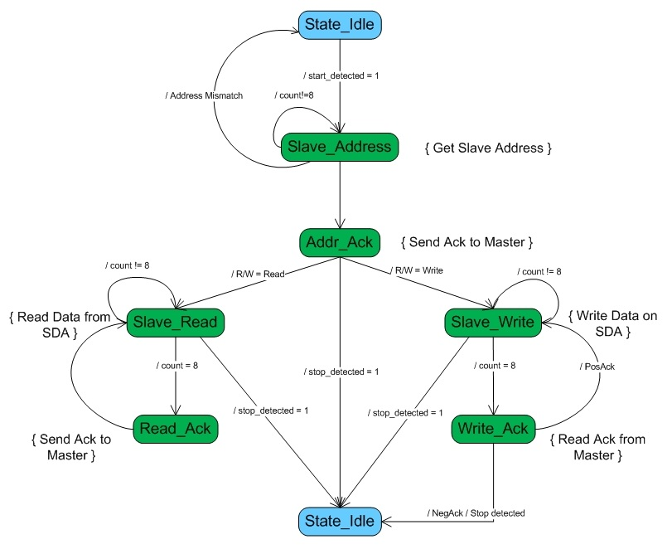
Finite State Machine

Slide 12
Slave Controller
Main module of the I2C Slave
Interfaces with Counter, Shifter and Start/Stop Detector Modules and control it
Implements the Finite State Machine
Works on Pos edge, Neg edge and Various signals and maintains timing synchronization

Slide 13
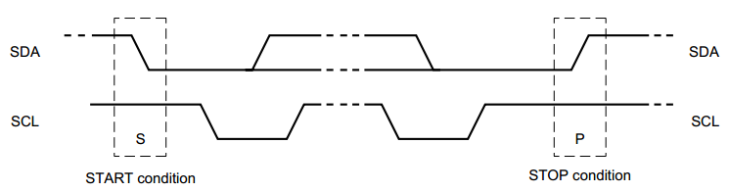
Start Stop Detector
Crucial module to detect the Start and Stop Bits
Need to detect the High -> Low and Low -> High Transition
Implemented Combinational Logic to Detect the Start/Stop

Slide 14
Shifter
Used to receive the Slave Address & incoming Data and to transmit the data to Master
Input - Serial In (SDA) or Parallel In (Slave Controller)
Output – Serial Out (SDA) or Parallel Out (Slave Controller)
Asynchronous Reset – to clear the data
Serial In Enable – Enables to shift in the incoming data
Serial Out Enable – Enables to send the stored data serially

Slide 15
Counter
Slave Address and Input/Output Data is of 8 bits width
Slave Controller starts the counter whenever it needs to read or write the multiple bits
Slave Controller waits for the signal from the Counter
Signal indicates that 8 bits are transmitted or received
Counter increments on the incoming SCL clock

Slide 16
Virtual Master
Needs to simulate the I2C Slave Module design
Virtual Master is designed to provide the Input on the SDA line to the I2C Slave
Clock is provided from the Clock Generator module at 100KHz
Master is consists of Verilog tasks
  Start
  send_slave_address_with_WRITE
  send_slave_address_with_READ
  send_DATA
  recv_DATA
  wait_for_ACK
  Send_ACK or Send_NegACK
  Stop

Slide 17
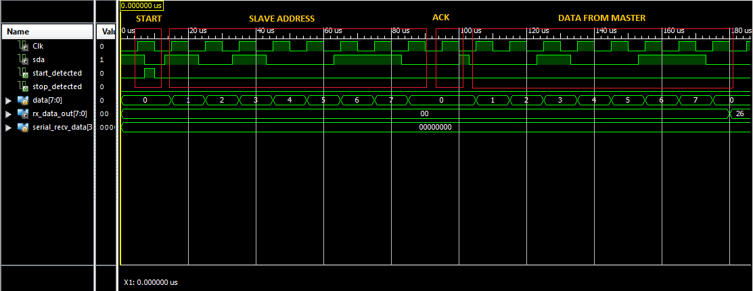
Simulation-Demo

Slide 18
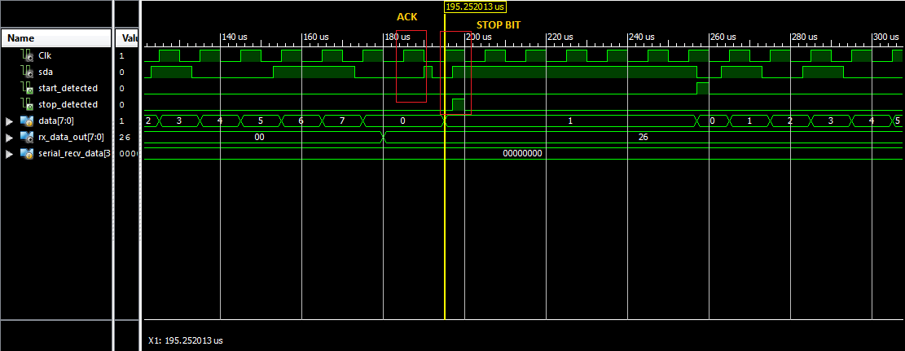
Simulation-Demo

Slide 19
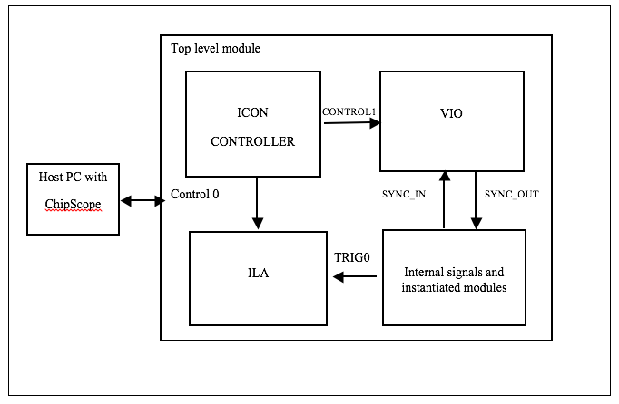
FPGA Implementation
ChipScope Pro Organization Details

Slide 20
FPGA Implementation
ICON (Integrated Controller)
  A controller module that provides communication between the ChipScope host PC and ChipScope modules in the design (such as VIO and ILA).
VIO (Virtual Input /Output)
  A module that can monitor and drive signals in design in real-time.
  These are virtual push-buttons (for input) and LEDs (for output).
  These can be used for debugging purposes, or they can be incorporated into the designas a permanent I/O interface.
ILA (Integrated Logic Analyzer)
  A module that lets you view and trigger on signals in your hardware design

Slide 21
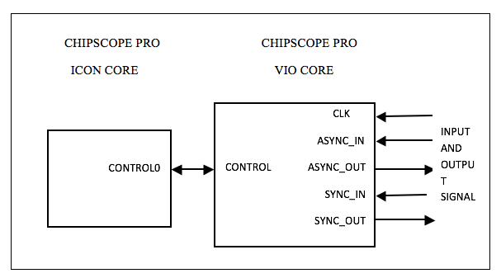
FPGA Implementation
VIO CORE connection to ICON CORE

Slide 22
FPGA Implementation
VIO CORE
  The LogiCORE™ IP ChipScope™ Pro Virtual Input/Output (VIO) core is a customizable core that can both monitor and drive internal FPGA signals in real time.
  Two different kinds of inputs and two different kinds of outputs are available, both of which are customizable in size to interface with the FPGA design

Slide 23
Challenges
Designing the Finite State Machine
Time Synchronization
Blocking Assignment Vs Non Blocking Assignment ☺
SDA Data should be setup before the SCL positive edge
Tri State Buffer for SCL and SDA
Start and Stop Detection Logic

Slide 24
Project Design Cycle
I2C Protocol Understanding
I2C Slave Design & System Block Diagram
Verilog Module Development and Unit Testing
Integration of Modules
Virtual Master & Testbench Design
System Testing, Debugging & Bug Fixing
FPGA Board Understanding
FPGA Implementation

Slide 25
Contribution
Amit Bhorania
  I2C Slave System Design
  Slave Controller – Finite State Machine
Ashutosh
  Virtual Master & Test Bench
  Start Stop Detector
Ravi
  Counter
  Shifter & Acknowledge
Ajinkya & Vaibhav
  FPGA Exploration & Implementation

Slide 26
Accomplishment
Main Goal
  Ready to use I2C Slave Module Design for Sensors
Benefits
  I2C Protocol Understanding
  Xilinx ISE Design Suite Learning
  Verilog Language Learning
  Project Development Life Cycle
  Debugging Skills & Bug Fixing

Slide 27
References
Philips I2C Specification
Verilog Coding
http://www.asic-world.com/verilog/index.html
Clocking using Chip scope pro
http://www.xilinx.com/support/documentation/user_guides/ug382.pdf
Xilinx Software and Documentation
http://www.xilinx.com/products/silicon-devices/fpga/spartan-6.html
Chip scope pro software and cores guide
http://www.xilinx.com/ise/verification/chipscope_pro_sw_cores_10_1_ug029.pdf

Slide 28
Questions…

Slide 29
Thank you

